Slide 1
VR for Hospital Fire Management
Work System Design Laboratory Group 2
SPRING 2021-2022

Slide 2
Our Team
Deepa Raj 20IM10006
Deepu Kumar 20IM10007
Dheeraj Gahlot 20IM10008
Chaitanya Dhuware 20IM10009
Gourav Kumar Shaw 20IM10010

Slide 3
INDEX OF CONTENT
MODEL PRESENTATION
OTHER IMPORTANT INITIATIVES TO BE TAKEN
WEEK-WISE PROGRESS
INFRASTRUCTURE PLANNING

Slide 4
HOSPITAL INFRASTRUCTURE PLANNING
A
B
C
Architectural planning
Layout planning
Interior planning
JUPITER

Slide 5
ARCHITECTURAL PLANNING
01
02
Sufficient open space between two buildings so as to minimize fire spread possibilities from other neighboring structure
There is enough space for movement and parking of fire fighting vehicles, ambulances, etc in the premises and wide road approach to the building.
03
04
The size and no. of occupancy, lobbies, staircase, ramps etc is sufficiently wide
Ensuring movement of traffic and quick evacuation during emergencies.

Slide 6
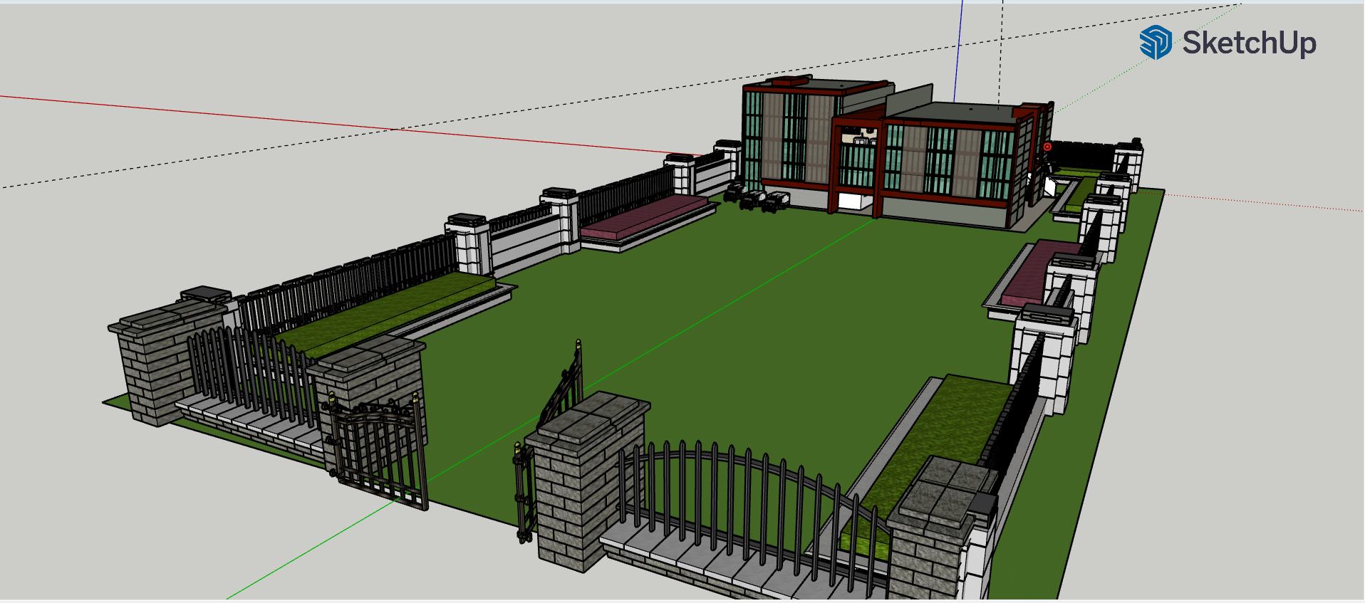
ARCHITECTURAL PLANNING: SUFFICIENT OPEN SPACE

Slide 7
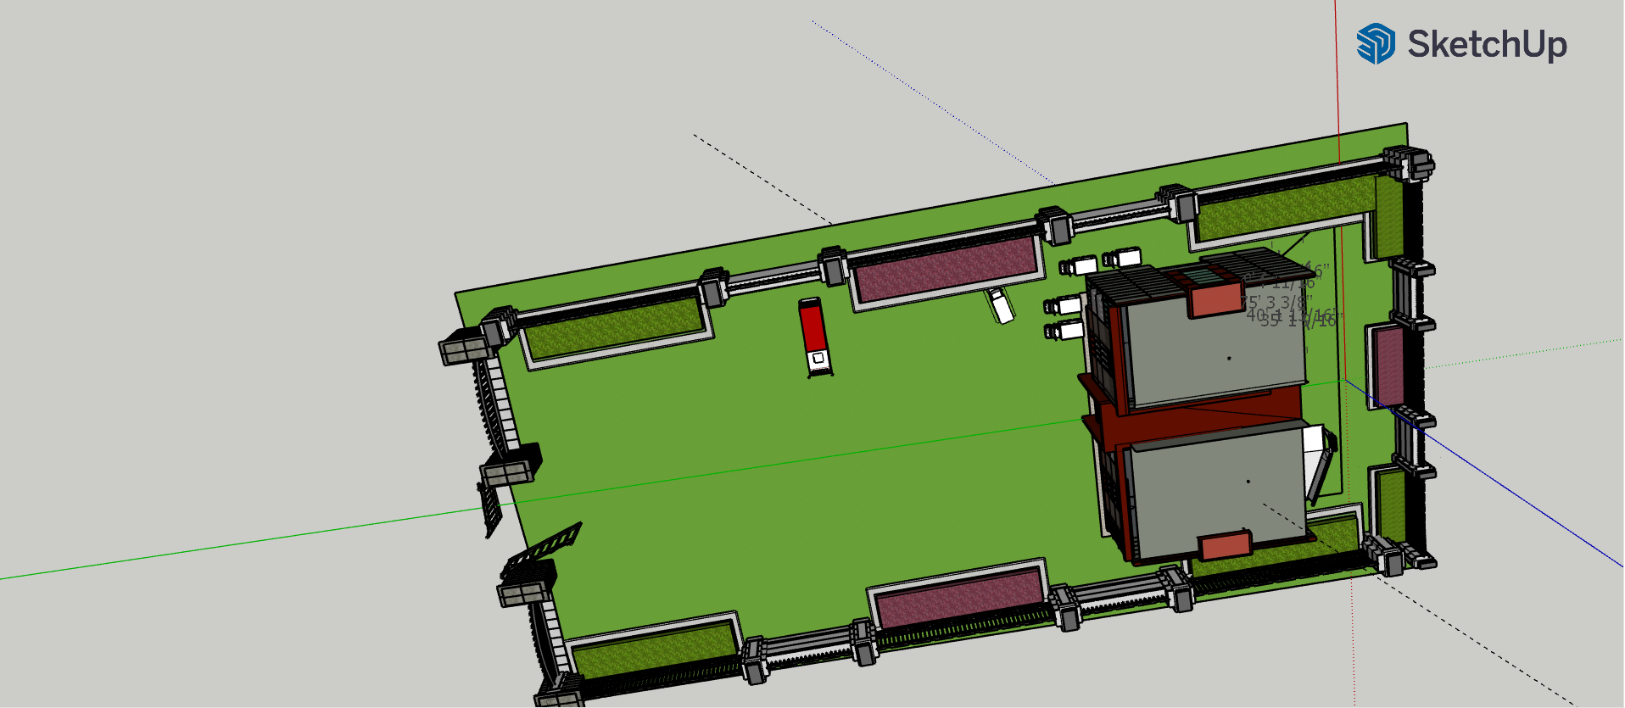
ARCHITECTURAL PLANNING: ENOUGH PARKING SPACE

Slide 8
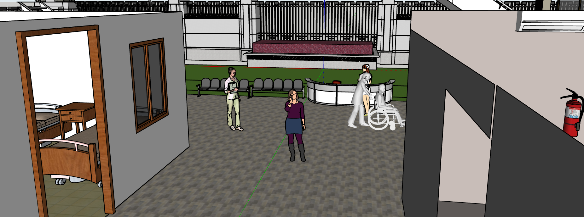
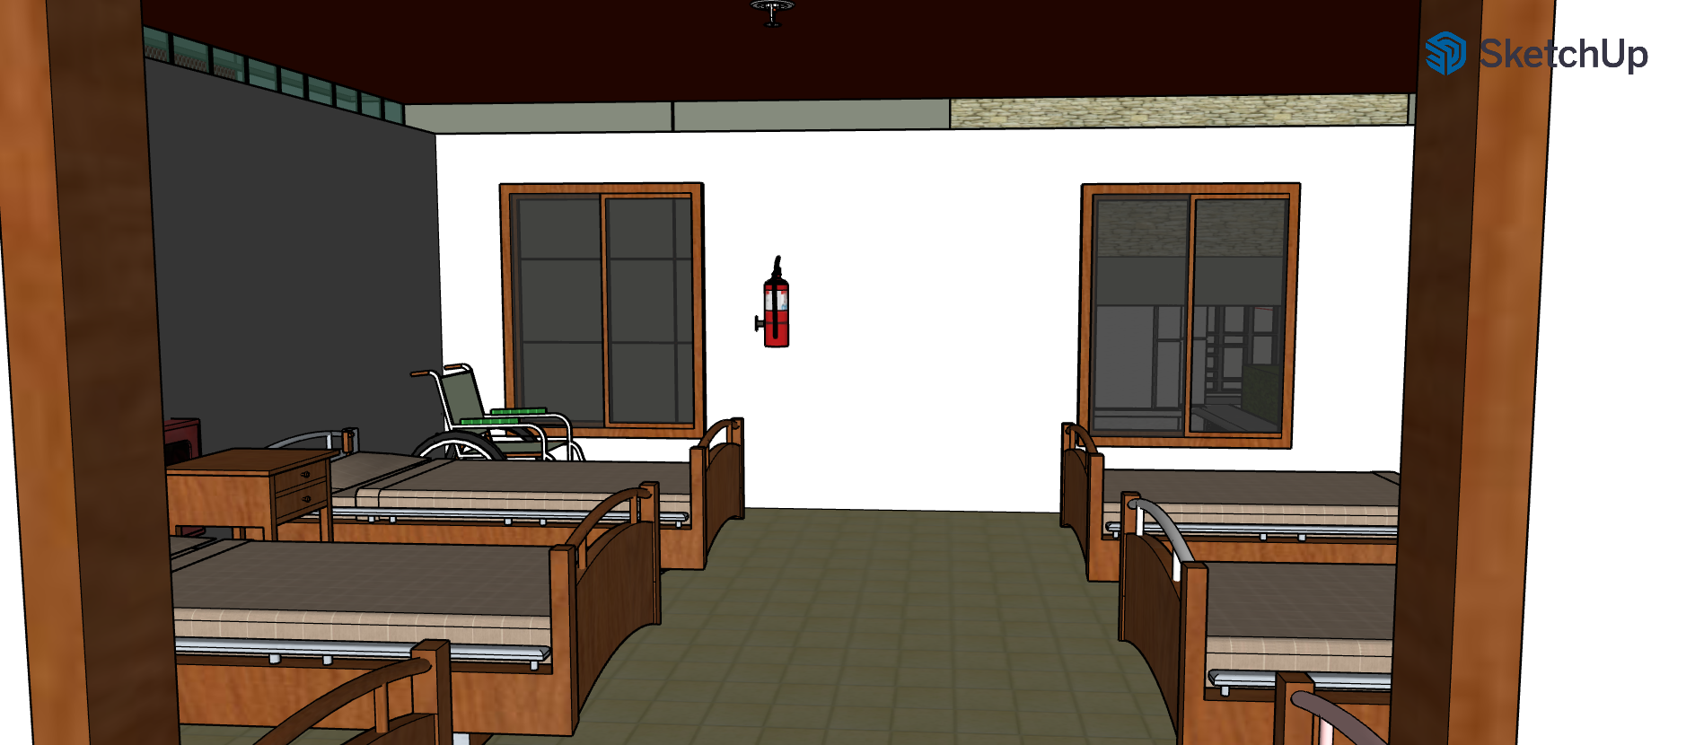
ARCHITECTURAL PLANNING: LOBBIES AND OCCUPANCIES

Slide 9
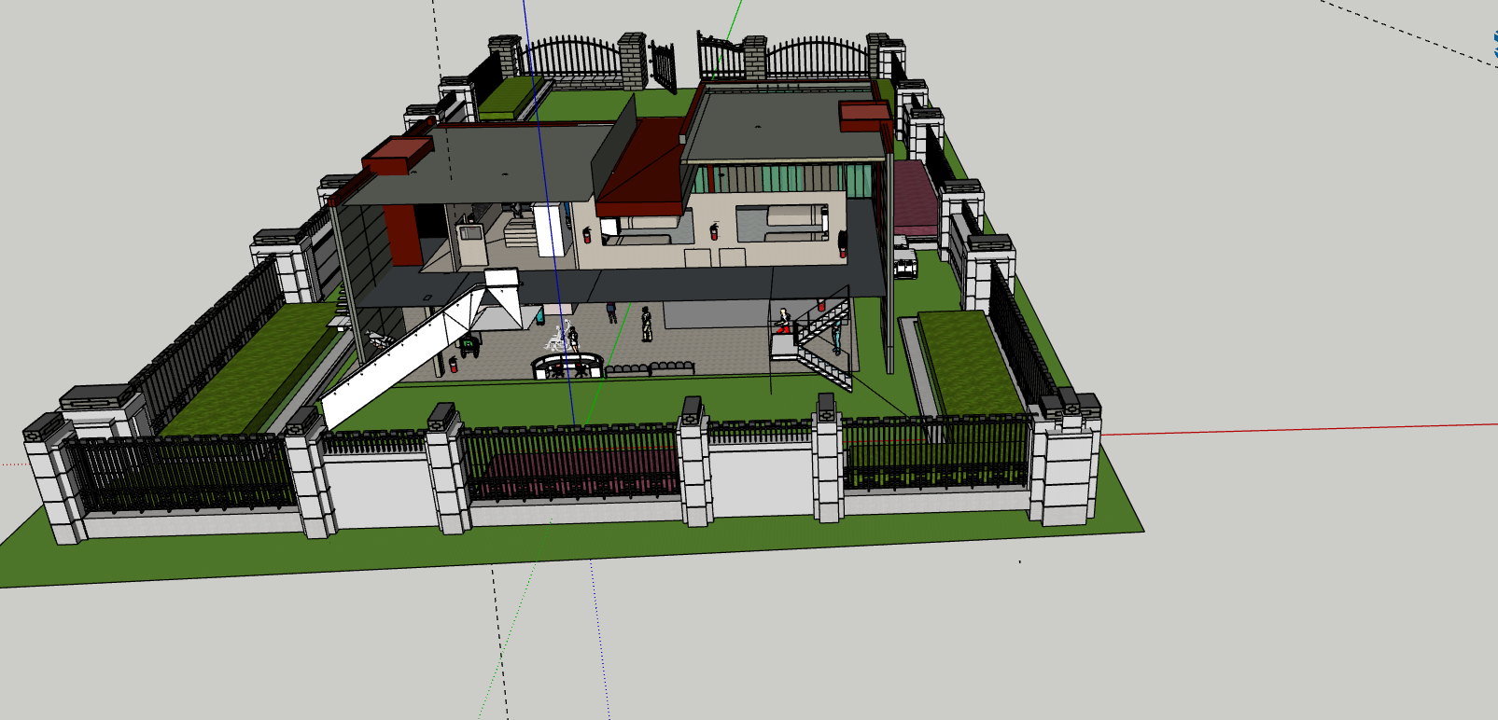
ARCHITECTURAL PLANNING: TRAFFIC MANAGEMENT

Slide 10
LAYOUT PLANNING
01
02
The design of the building structure so planned that it allows pressurized exclusion of smoke in case of fire or any smoke leak.
Must have enough doors and widows
03
04
Safe and easy means of access provided to and in every place of work / in patient area.
In case of emergency , safe and rapid exit provided for all occupants. Each building must have separate fire exit, staircase with proper signage

Slide 11
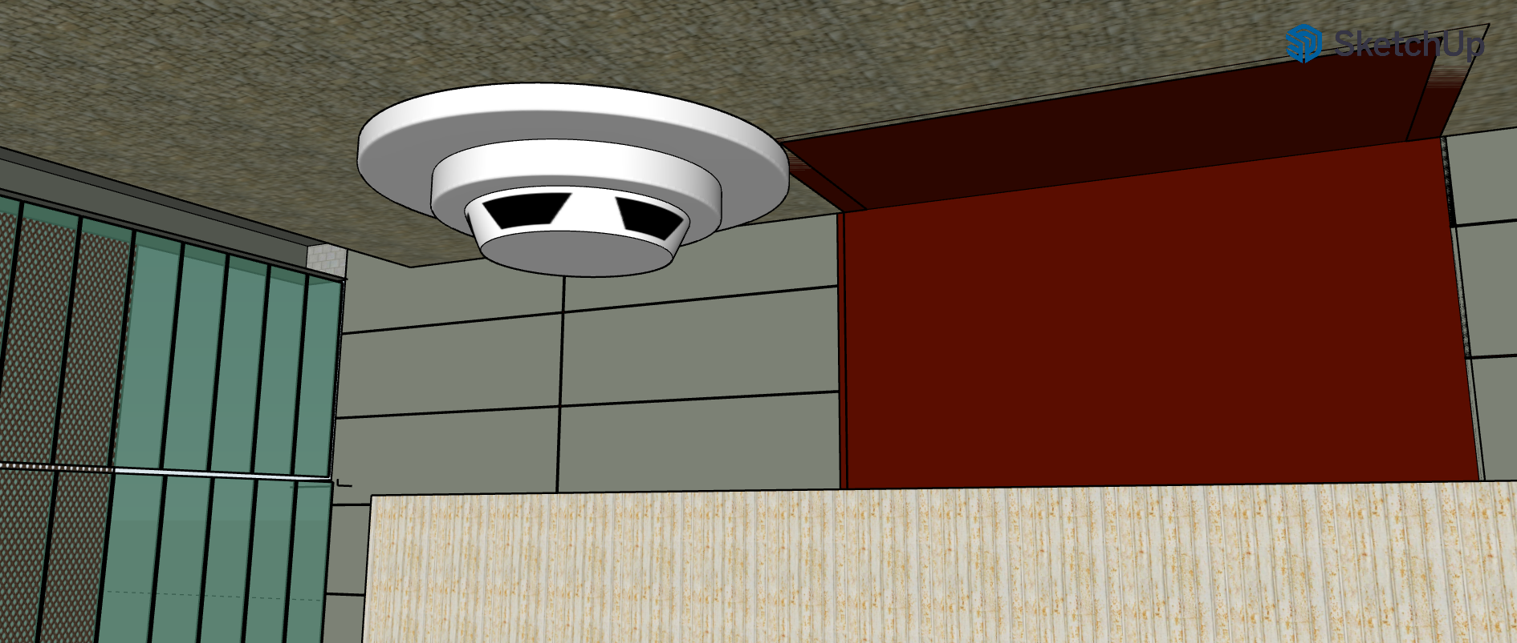
LAYOUT PLANNING: SMOKE EXCLUSION

Slide 12
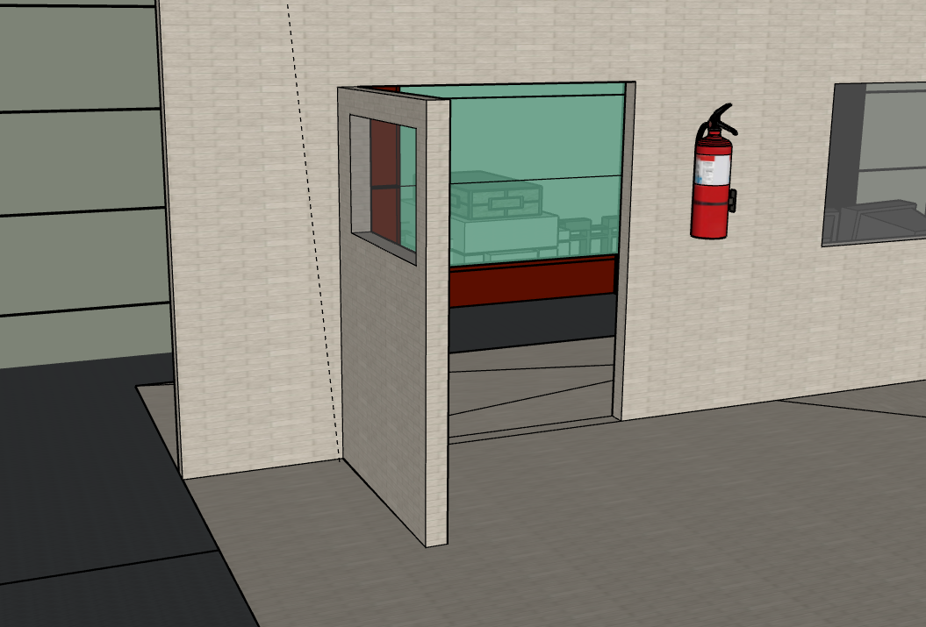
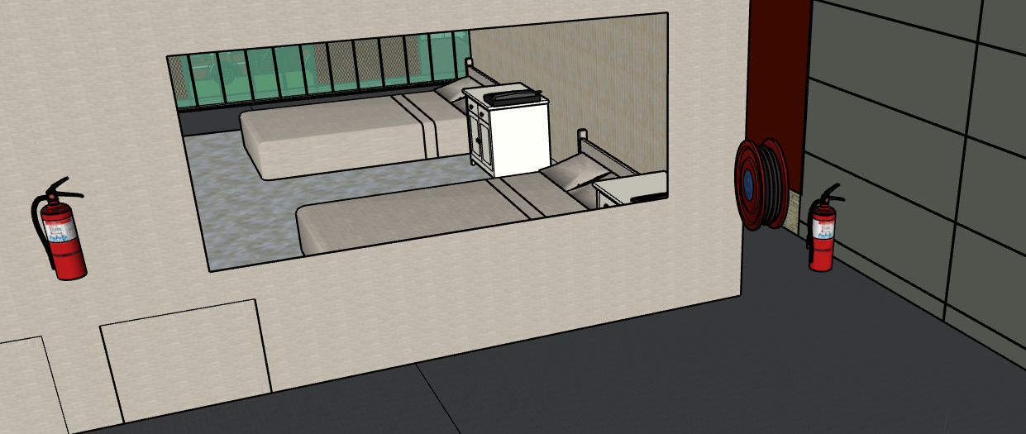
LAYOUT PLANNING: DOORS AND WINDOWS

Slide 13
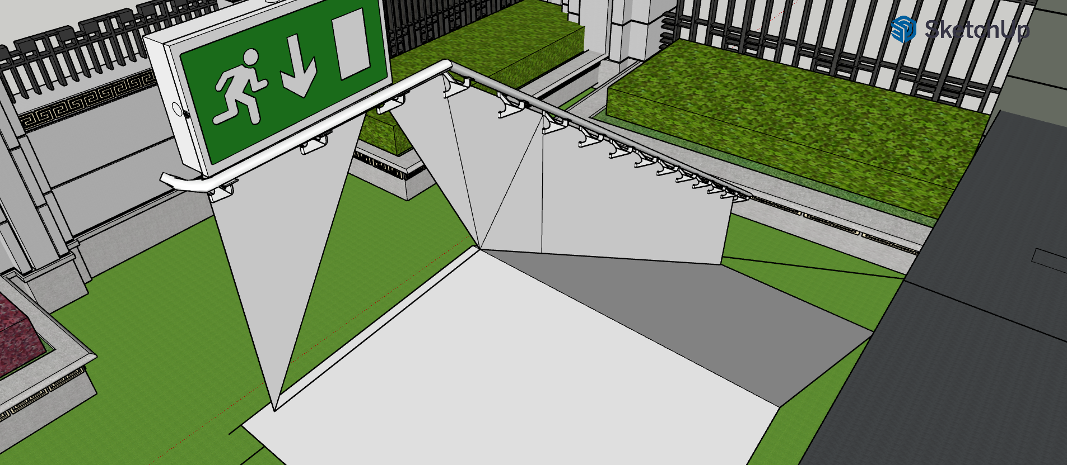
LAYOUT PLANNING: EMERGENCY EXITS

Slide 14
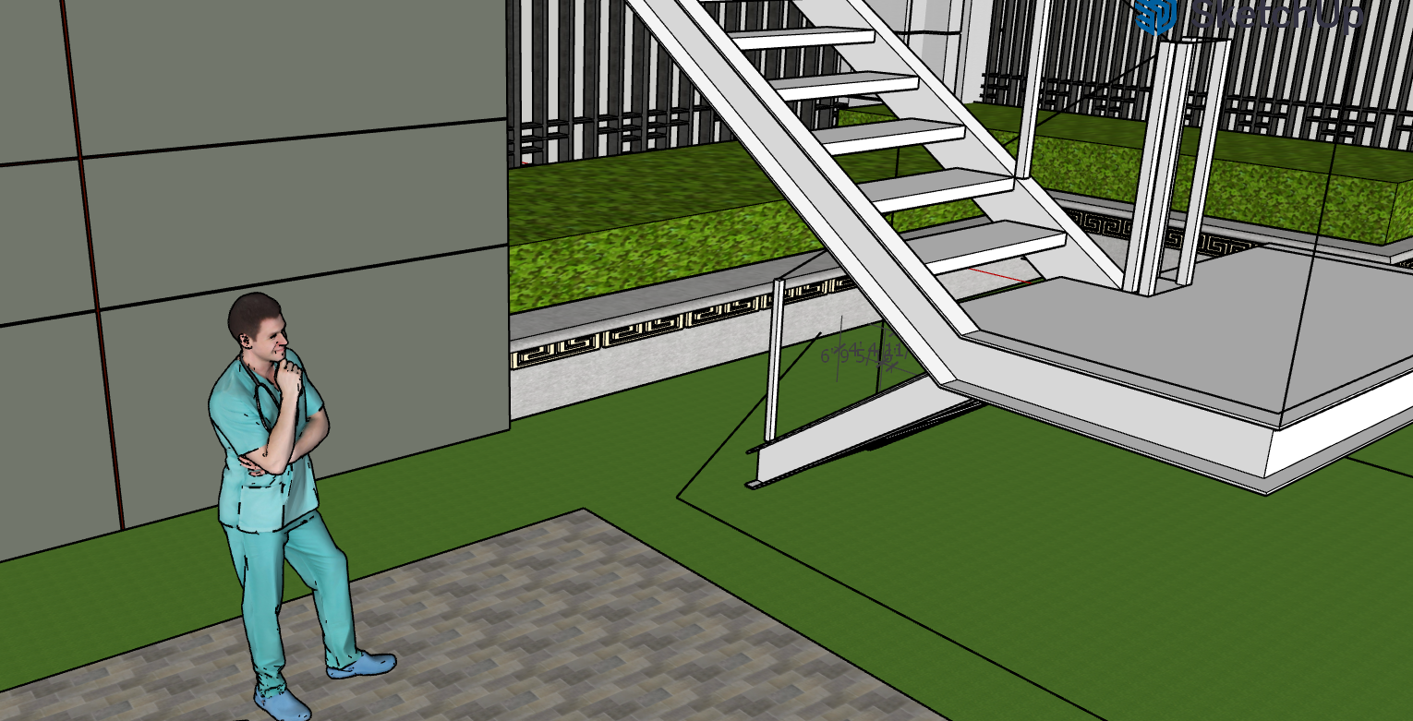
LAYOUT PLANNING: EASY ACCESS

Slide 15
INTERIOR PLANNING
01
02
The floors are so designed that they are free from obstructions , are slip resistance and even.
Openings in floors are securely fenced or covered
03
04
Staircase, ramps should be provided with substantial handrails and other suitable support to prevent slipping , where ever necessary
Interior should have fire proof doors, windows, walls and roof covered with fire proof materials

Slide 16
INTERIOR PLANNING: STAIRS AND OPENINGS

Slide 17
MODEL PRESENTATION

Slide 18
INITIATIVES NEEDS TO BE TAKEN BY THE PEOPLE
Coordination & Management
Planning
& Training
&
Drills
Information
&
Communication
Logistics
&
Supply
&
Finance Management

Slide 19
FEATURES OF THE MODEL
Fire & Smoke Alarms
Fire extinguisher
Enough fire exit doors
Wheelchairs exit stairs
Fire fighting vehicle
Air ventilation

Slide 20
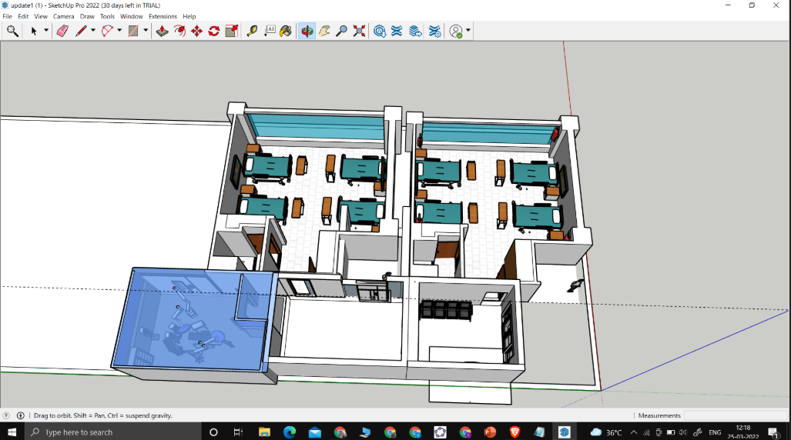
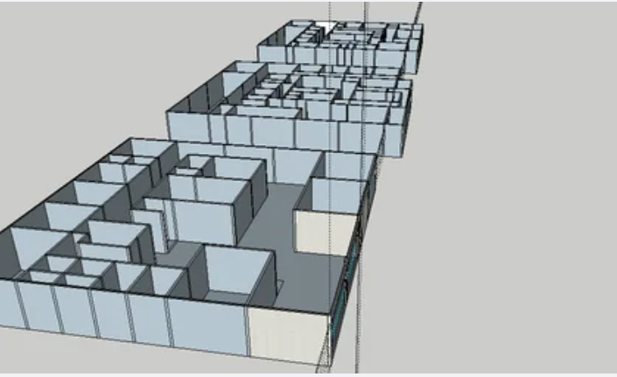
WEEK WISE PROGRESS

Slide 21
THANK YOU

